Slide 1
Business Intelligence For Support Staff.

Slide 2

Hello!
We are Databrains
And we are the responsible for realizing the Business Intelligence for the support staff project.

Slide 3
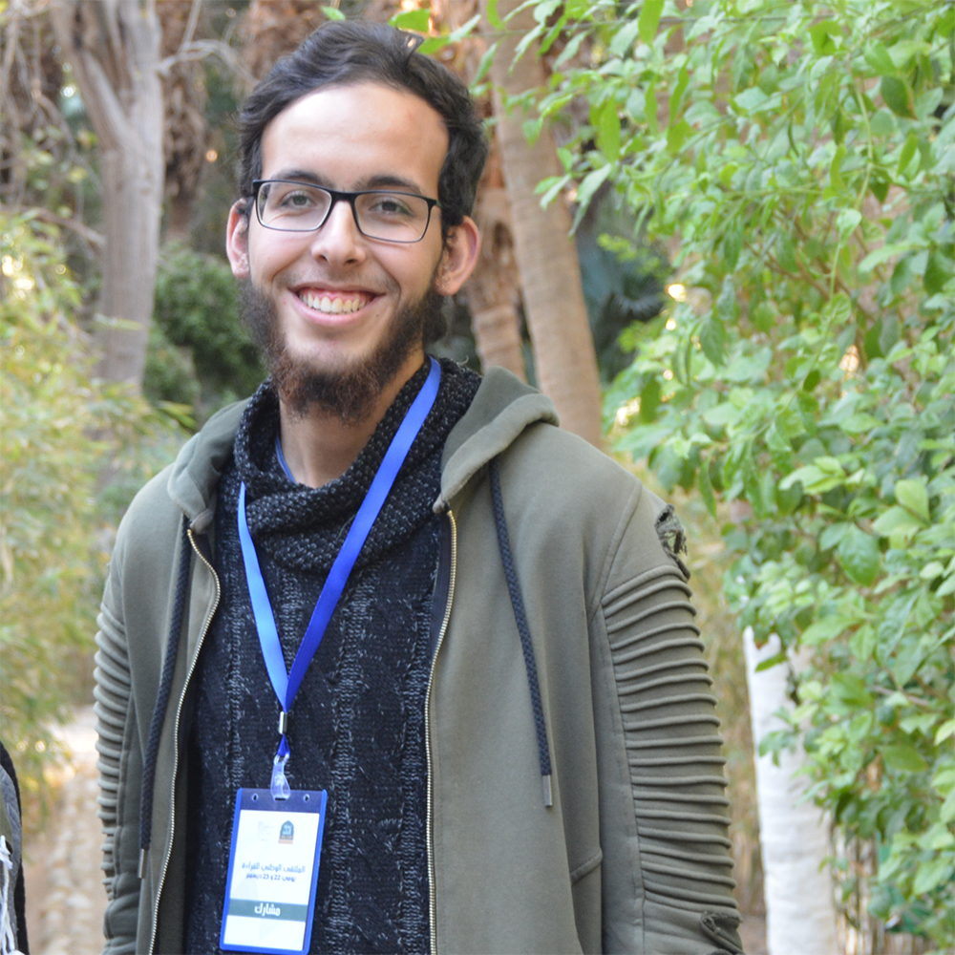




Our Team Crew
Ismail
BOURBAI
Houari
ZEGAI
Nour El Imane
NADJEM
Younes
CHARFAOUI
Malika
MADENE

Slide 4

Welcome !
To our client: Mr. Talbi Omar
To our guest: Mr. Merati Medjeded
Framed by: Mr. Ouared Djilali

Slide 5
Data will talk to you if you’re willing to listen to it.

Slide 6
1. Introduction
Let’s start with a Brief talk about the BI4SS Project

Slide 7
University Data
The data of the university has been not used to make decision before, it was just in the state of operations, by this project, we transformed the state into decision making with this data.

Slide 8

Objective
The purpose is how can teachers determinate the causes of the success and failure of students.

Slide 9

Solution
Multiple ways had been token to answer this question like : sociologists studies , Meeting, formulas , teachers meetings every end of year But Still no answer.
The idea now is exploiting this data by including Bi & Data mining technologies and trying to achieve what we are supposed to do

Slide 10

2. Specification
The Client Requirements.

Slide 11



Users
Student
Teacher
Academy

Slide 12
Requierements
Functional: The system must help to determine the causes of success and failure of students by displaying graphs according to his:
Socio demographic profile
School path
Study practices
Living conditions

Slide 13

Requierements
Non Functional requirement: The system work on 2 platforms
Mobile
Destined to Students
Desktop
Destined to Teachers & Academy

Slide 14

3. Work Plan
A Good Plan Means a Successful Project.

Slide 15
The bad new is the time flies
The good news is you’re the pilot

Slide 16
Planification
Name | Begin date | End date
Familiarizing with technological tools. | 06/12/18 | 03/01/19
Gathering information sources. | 17/12/18 | 18/12/18
Data Mart Design. | 19/12/18 | 24/12/18
Checking validity. | 25/12/18 | 25/12/18
Elaborating CDM. | 25/12/18 | 25/12/18
Elaborating LDM & PDM. | 26/12/18 | 26/12/18
Checking validity. | 27/12/18 | 27/12/18
PMD Implementation. | 27/12/18 | 27/12/18
Data mining. | 28/12/18 | 03/01/19
Checking with stakeholders. | 04/01/19 | 04/01/19
Server implementation. | 04/01/19 | 08/01/19
UI & UX mobile design. | 04/01/19 | 08/01/19
UI & UX desktop design. | 04/01/19 | 08/01/19
Coding & testing. | 09/01/19 | 15/01/19
Planning presentation. | 16/01/19 | 17/01/19

Slide 17

3. Methodology
Explain all the norms adopted to realize the conception activity.

Slide 18
Phases
KDD
UML
process of finding knowledge in data
We always need the modeling and the conception of our apps,
Scrum Method
4
iterative and incremental method for managing software development.
2
Snowflake schema
Used for the multidimensional modelisation
1
3

Slide 19

5. Multidimentionnal Conception
Let’s descripe all the DataMarts

Slide 20
Data Marts
Student
Id_student Scholar_year Gender Nationality Bac_wilaya Status Repeated Bac_average …
1
Result
Id_student Scholar_year Id_course …
Profil
Id_student Id_course Scholar_year Exam Td Tp Average
Profile
Course
Id_course Scholar_year Id_branch Course_title Semester …

Slide 21
Data Marts
Student
Id_student Scholar_year Gender Nationality Bac_wilaya Status Repeated Bac_average …
HightSchl_info
Id_student HightSchl_year Delay …
2
School_Path
Id_student Scholar_year Exam Average Td Tp
School Path
HightSchl_Result
HightSchl_year T1_average T2_average T3_average Mention …
Result
Id_student Scholar_year Id_course …

Slide 22
Data Marts
Student
Id_student Scholar_year Gender Nationality Bac_wilaya Status Repeated Bac_average …
3
Result
Id_student Scholar_year Id_course …
Study_Pract
Id_student Scholar_year Exam Average Td Tp
Study Practices
Course
Id_course Scholar_year Id_branch Course_title Semester …
Absence
Id_course Course_abs Td_abs Tp_abs …
Add_H_Volume
Id_student Add_H Add_work …

Slide 23
Data Marts
Student
Id_student Scholar_year Gender Nationality Bac_wilaya Status Repeated Bac_average …
Living_Condit
Id_student Scholar_year Id_disease Id_parentsW Id_resid Average Exam Td Tp
Result
Id_student Scholar_year Id_course …
4
Living Conditions
Parents_Work
Id_student Parent_work Parent_study_level …
Diseases
Id_disease Id_student isCronic …
Residence
Id_Student Type …

Slide 24

6. Tools List
We will specify all the tools used :
IDE, langages… etc.

Slide 25







IDE’s

Slide 26




Langages

Slide 27



Data warehouse
& DBMS
27

Slide 28
7. Data Treatment
Stage In Which The Core of The Data warehouse is created.

Slide 29

Extraction
We told the job how to do the extraction
1
3
2
We designed something called jobs inside the software
Then we execute the jobs we built

Slide 30


Cleaning
Here we did filtering all the outlier data that can cause a problem in the data warehouse analysis and data mining processes

Slide 31
8. Data Mining
Another core task when doing a data warehouse.

Slide 32
ML Algorithms
Clustering
Deep Neural Networks, Support vector machine, K-Nearest Neighbors, Logistic regression, Naïve Bayes, Decision Tree, Random Forest, Linear Regression
Classification and Regression
Association Rules
Dimensionality Reduction
Hierarchical Clustering, K-Means Clustering
Apriori Association rule, Eclat
Principal Component analysis (PCA)
2
1
3
4

Slide 33

Problems To solve With ML
We’ve got a lot of ideas that can be handled intelligently using Machine learning Algorithm to extract some relationship. The next slides show the problems.

Slide 34

Problems #1
Make a machine learning model to help the support staff for accepting new student into the university according to their profile.
Deep NN | KNN | SVM
82% | 81% | 81%

Slide 35

Problems #2
Finding some association rule between the courses of the university.
Algorithm | Results Example
Apriori | Component Approaches => Admin Networks & Prog Sys
Eclat | Advanced Database and Datamining => Logic For AI

Slide 36

Problems #3
Help students in choosing the right branch for them in the master level.
Algorithm | Accuracy
K-Means | 20%
Hierarchical clustering | 51%

Slide 37

Problems #4
Help first year Students in choosing the right branch in the second year which consists of Mathematics or computer science.
No Results Was Provided

Slide 38

Problems #5
Prove that the student who gets good averages in the algorithmic subjects in the first year of their curriculum, has a great likelihood to succeed in the rest of it.
The Diagram Provided Show that Algorithm is Mandatory for success.

Slide 39

Difficulties
The main difficulty that we faced was the data itself, it wasn’t that much consistent and ready for mining. Either we did several algorithms but we didn’t arrive to what we wanted.
Maybe because of our high expectations

Slide 40
9.Practical demostration
Now we will pass to show you the realized apps with the two plateformes

Slide 41
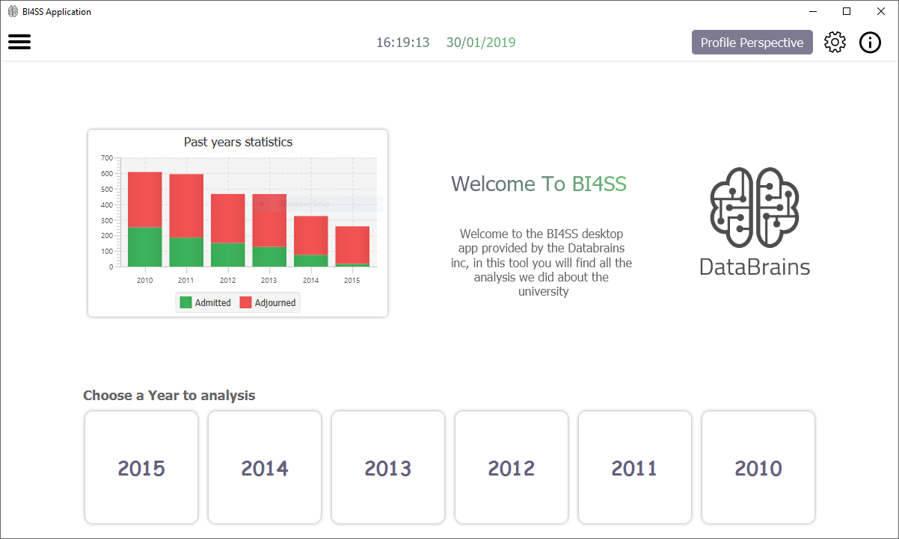
Desktop project
Place your screenshot here
First of all we will show the desktop app

Slide 42
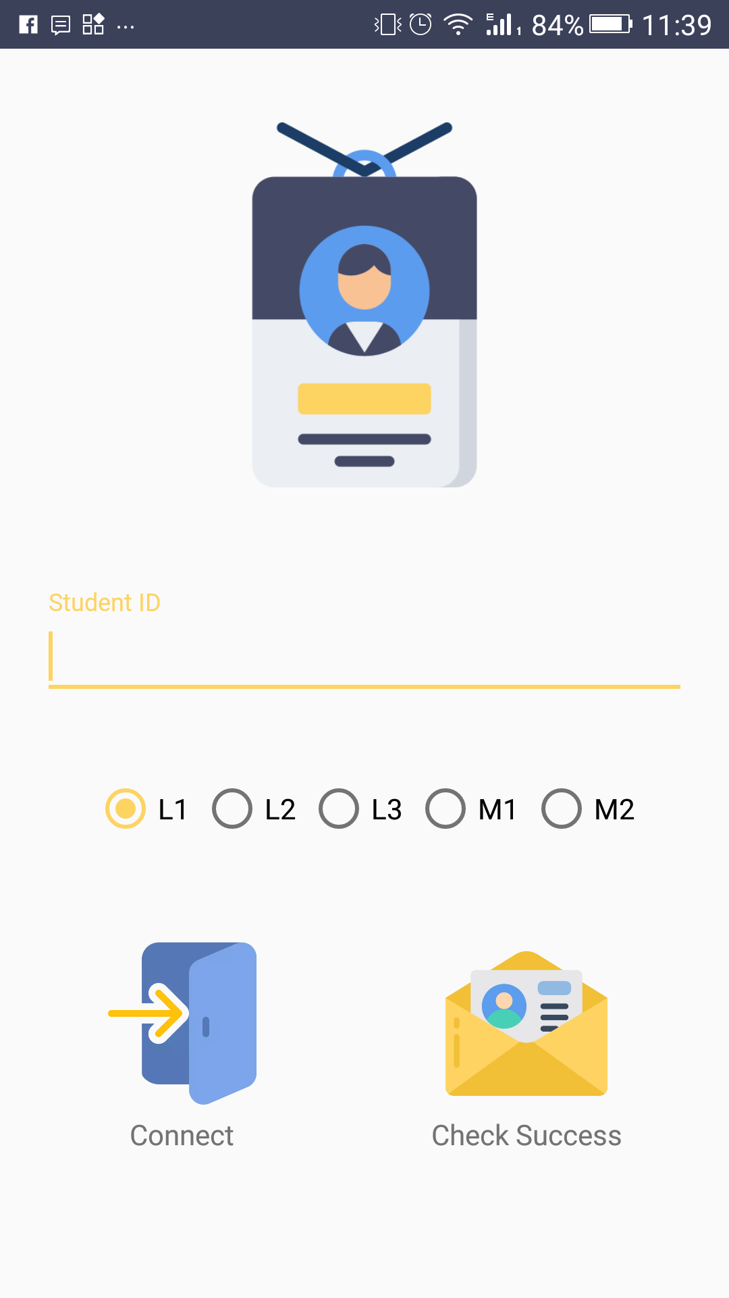
Mobile project
Place your screenshot here
This is the Login activity

Slide 43
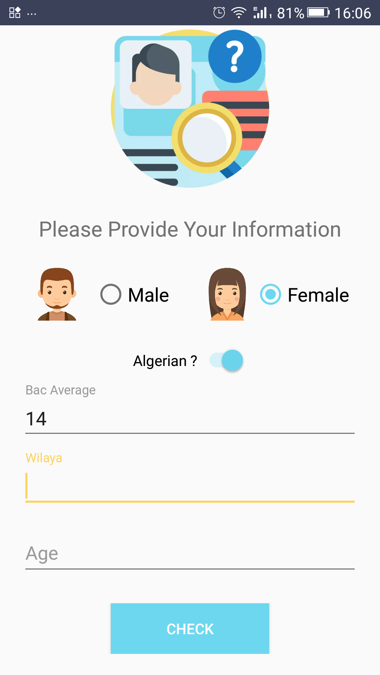
Mobile project
Place your screenshot here
This activity to pridect the success or fail for the new students

Slide 44
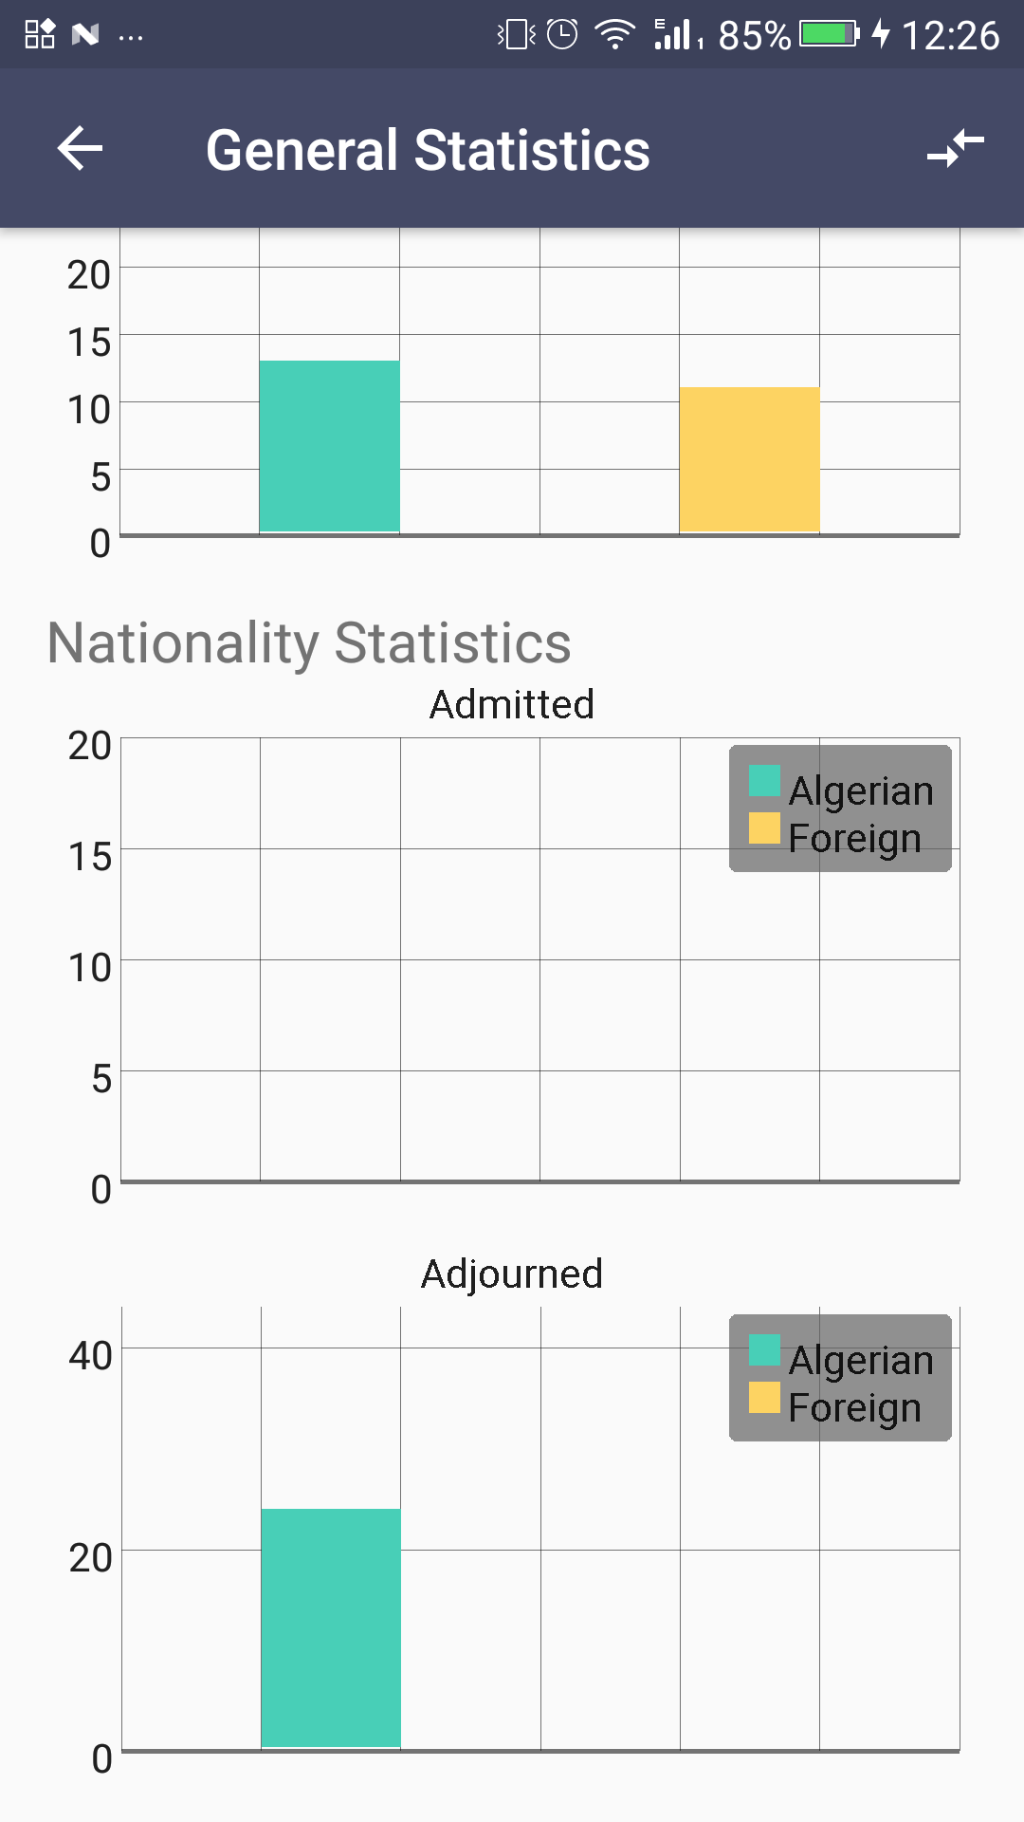
Mobile project
Place your screenshot here
This activity present the general statistics of the chosen year

Slide 45
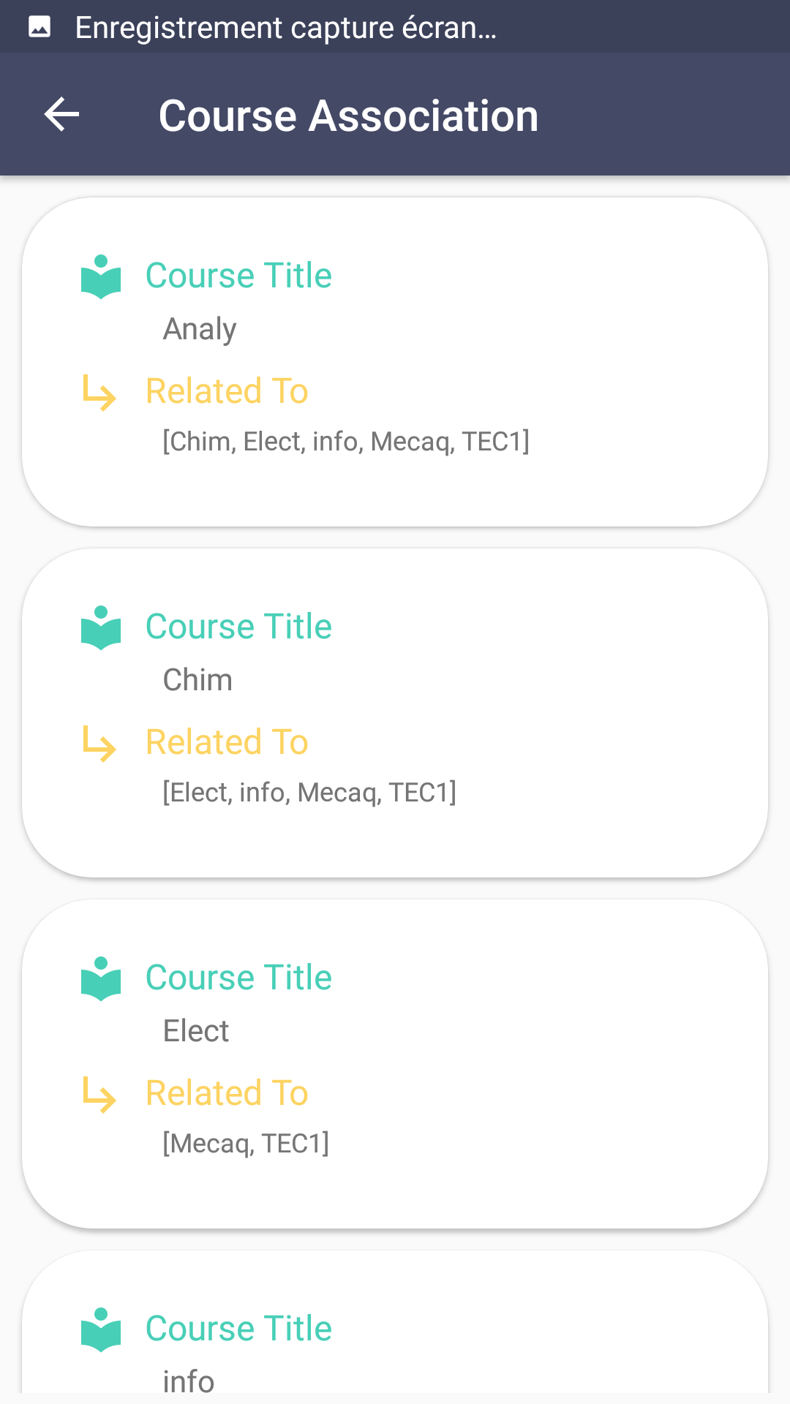
Mobile project
Place your screenshot here
This activity shows the associations between courses

Slide 46



Thanks!
Any questions?
support@databrains.dz
@DatabrainsDz
www.databrains.dz

